Slide 1
Modern Versions of the Teleological Argument
Today you will be learning two types of modern design arguments and their supporting philosophers

Slide 2
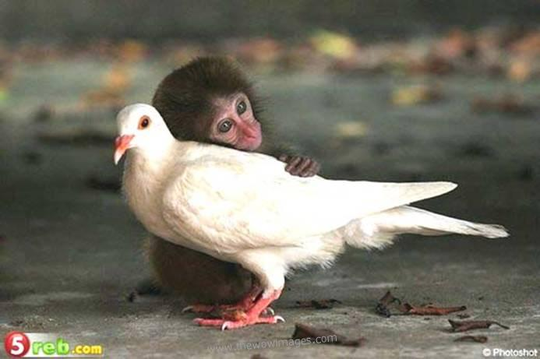
http://www.youtube.com/watch?v=Ol98METL6w0
Notes:
What’s the idea for this part of the design argument?

Slide 3
Beauty of the World

Slide 4
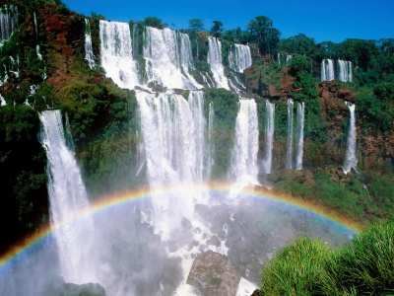
Beauty of the World

Slide 5
Beauty of the World

Slide 6
Beauty of the World

Slide 7
Aesthetic Argument
Aesthetic = related to the concept or appreciation of beauty
Why do humans appreciate the beauty of the world?
Is our appreciation of the beauty of the world essential for us to survive?
Is this evidence of a benevolent God?

Slide 8
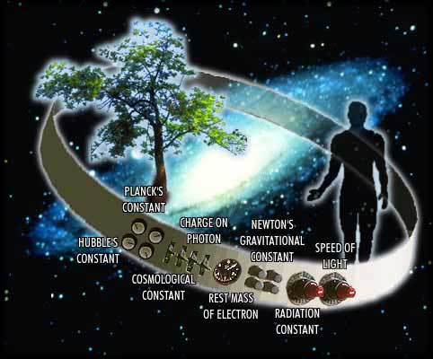
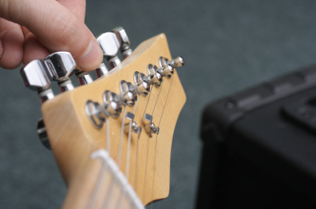
Anthropic Principle
http://www.youtube.com/watch?v=KowO5wj6Awo
Otherwise known as the argument from Fine Tuning

Slide 9
Anthropic Principle
What are the chances of human life on earth?
What are the chances for conditions on earth to be so perfect as to support human life?
Does this prove an intelligent designer?
Do scientific discoveries support this idea or challenge it?

Slide 10
In pairs- given one argument
Read through and learn your topic
Anthropic arguments
Aesthetic arguments
Then ‘teach’ your partner about your arguments (Tennant goes first!)

Slide 11
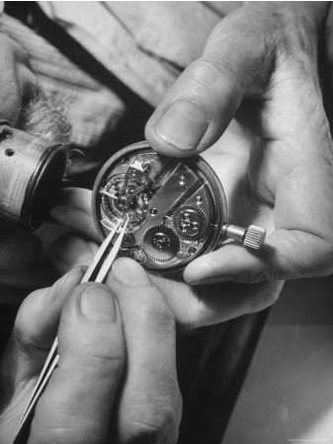
Aesthetics- Beauty can only be explained by God
Modern scholars like FR Tennant (1866-1957) and R Swinburne (1934- ) advance the design argument by moving away from the use of analogy
Analogy suggests a similarity between God and human designers– how far do we take this comparison? What do we transform God into?
For Tennant (Bk: Philosophical Theology 1930), God is the best explanation for the beauty, regularity and order in the world [the God hypothesis]

Slide 12
From FR Tennant we get an Aesthetic Argument
AESTHETIC ARGUMENT – Humans appreciate aesthetic activities such as art, music and literature: which are not necessary for mere survival so cannot have come about through natural selection so must be the product of a designing creator
“Our scientific knowledge brings us no nearer to understanding the beauty of music…beauty seems to be superfluous and to have little survival value.”
Nature is meaningless and valueless, without God behind it and man in front. (F. R. Tennant)

Slide 13
Likewise- Richard Swinburne’s Argument from Beauty
“In consequence, if the world is beautiful, that fact would be evidence for God's existence.”
“Few, however, would deny that our universe has beauty. Poets and painters and ordinary men down the centuries have long admired the beauty of the orderly procession of the heavenly bodies, the scattering of the galaxies through the heavens (in some ways random, in some ways orderly), and the rocks, sea, and wind interacting on earth, 'The spacious firmament on high, and all the blue ethereal sky', the water lapping against 'the old eternal rocks', and the plants of the jungle and of temperate climates, contrasting with the desert and the Arctic wastes. Who in his senses would deny that here is beauty in abundance? If we confine ourselves to the argument from the beauty of the inanimate and plant worlds, the argument surely works.”

Slide 14
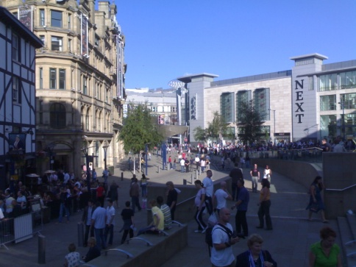
Anthropic principle- from Greek word Anthropos meaning Man
Physical matter gathers together in galaxies, stars and planets because of gravity. The gravity balance is perfect for us to survive.
Therefore, the universe has been so ‘finely tuned’ it could not have been a matter of chance.
Humans could only survive in this kind of universe.

Slide 15
Anthropic Principle
argues that the world had to be as it is in order for us to be here. There must have been some built in factor which made the development of human life inevitable.
The chances of conditions on earth being so perfect to allow human life to develop by chance is unfathomable.
The fact we are here demonstrates ‘fine tuning’ for the purpose of human existence.
Implies a designer!

Slide 16
Further support from scientists
Scientist Arthur Brown states the Ozone layer is an exact depth to prevent humans from being killed by dangerous rays, and therefore is evidence of a “designing mind behind the universe.”
Paul Davies in his book The Mind of God goes so far as to argue that “the accuracy required at the earliest moment of the Big Bang is equivalent to mankind hitting a one inch target from a distance of twenty billion light years!”
John Polkinghorne (1930-) a Physicist and Anglican Priest, argues God is the “total explanation for the universe...and the continuing act of creation as seen through the unfolding process of evolution.”

Slide 17
Richard Swinburne’s Anthropic argument in more detail
Two factors-
Regularity of Co- Presence
The order in the universe is a product of what he calls regularity of co-presence, implying that everything works together in an orderly manner following an orderly arrangement of its parts. E.g. Parts of a human body, parts of a plant...
(2) Regularity of Succession
The order in the universe is also a product of regularity of succession (basically same as design qua regularity), whereby things follow a set pattern or instruction in order to function. These instructions are external to our own intelligence. E.g. The vein/artery system

Slide 18
Swinburne’s example
‘The mad kidnapper with the
Explosive card shuffling machine’ Analogy
“Suppose that a madman kidnaps a victim and shuts him a room with a card-shuffling machine. The machine shuffles ten decks of cards simultaneously and then draws a card from each deck and exhibits simultaneously the ten cards. The kidnapper tells the victim that he will shortly set the machine to work and it will exhibit its first draw, but that unless the draw consists of an ace of hearts from each deck, the machine will simultaneously set off an explosion which will kill the victim, in consequence of which he will not see which cards the machine draws. The machine is then set to work, and to the amazement and relief of the victim the machine exhibits an ace of hearts drawn from each deck. The victim thinks that this extraordinary fact needs an explanation in terms of the machine having been rigged in some way. But the kidnapper, who now reappears, casts doubt on this suggestion. ‘It is hardly surprising,’ he says, ‘that the machine draws only aces of hearts. You could not possibly see anything else. For you would not be here to see anything at all, if any other cards had been drawn.’ But of course the victim is right and the kidnapper is wrong... The fact that this peculiar order is a necessary condition of the draw being perceived at all makes what is perceived no less extraordinary and in need of explanation. The teleologist’s starting-point is not that we perceive order rather than disorder, but that order rather than disorder is there. Maybe only if order is there can we know what is there, but that makes what is there no less extraordinary and in need of explanation.”

Slide 19
Swinburne’s example
‘The mad kidnapper with the
Explosive card shuffling machine’ Analogy
So we should not take the odds of conditions for life lightly- we should indeed wonder at the chances! This is a comeback to the criticism of only ‘apparent design’. Just because design is apparent doesn’t mean it is not authentic!
“Suppose that a madman kidnaps a victim and shuts him a room with a card-shuffling machine. The machine shuffles ten decks of cards simultaneously and then draws a card from each deck and exhibits simultaneously the ten cards. The kidnapper tells the victim that he will shortly set the machine to work and it will exhibit its first draw, but that unless the draw consists of an ace of hearts from each deck, the machine will simultaneously set off an explosion which will kill the victim, in consequence of which he will not see which cards the machine draws. The machine is then set to work, and to the amazement and relief of the victim the machine exhibits an ace of hearts drawn from each deck. The victim thinks that this extraordinary fact needs an explanation in terms of the machine having been rigged in some way. But the kidnapper, who now reappears, casts doubt on this suggestion. ‘It is hardly surprising,’ he says, ‘that the machine draws only aces of hearts. You could not possibly see anything else. For you would not be here to see anything at all, if any other cards had been drawn.’ But of course the victim is right and the kidnapper is wrong... The fact that this peculiar order is a necessary condition of the draw being perceived at all makes what is perceived no less extraordinary and in need of explanation. The teleologist’s starting-point is not that we perceive order rather than disorder, but that order rather than disorder is there. Maybe only if order is there can we know what is there, but that makes what is there no less extraordinary and in need of explanation.”

Slide 20
Swinburne concludes, arguing from probability
He asks the simple question-
which explanation for the apparent design is more likely?
Random chance or a conscious designer?
He concludes
“To postulate a trillion trillion other universes, rather than one God in order to explain the orderliness of our universe, seems the height of irrationality.” (Challenging Epicurean Hypothesis)

Slide 21
Which is the strongest?
Aesthetics or Anrthropic?
Do they overcome the scientific challenges we have looked at?
Homework
For next lesson come up with a short starter task for the class that will recap one of the following:
Aristotle Aquinas Paley Hume Mill Kant Darwin Dawkins Tennant Swinburne Arthur Brown/ Paul Davies/Polkinghorne

