Slide 1
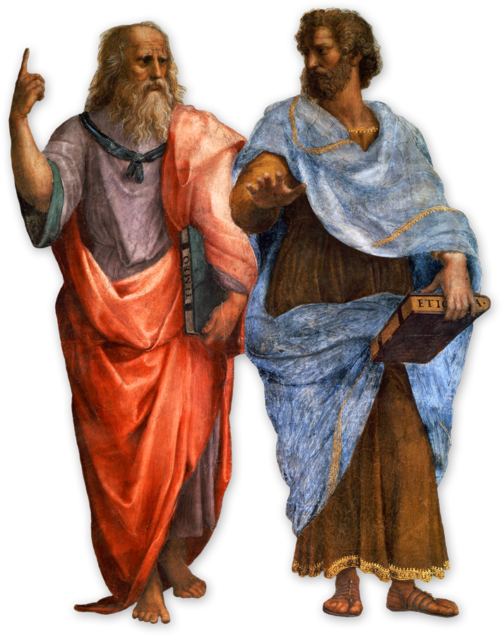
Aquinas was influenced by Aristotle
Aristotle
What do you know about Aristotle’s ideas concerning the
cause of things?
Four causes?
Potentiality to actuality?
Plato

Slide 2
Potentiality & Actuality
There are two states of being:
Potentiality – the possibility of doing something or becoming something.
Actuality – when potential is achieved.

Slide 3
For example…
You have the potential to achieve a super grade in AS Religious Studies.
It is not yet actualised because you haven’t achieved it yet.
Just because there is the potential does not mean it will definitely be actualised.
You have to work hard to achieve it!
So the idea is in order for things to fulfil their potential- to reach or ‘actualise’ their purpose, certain things have to happen/ be done.... ‘regulated’ even?

Slide 4
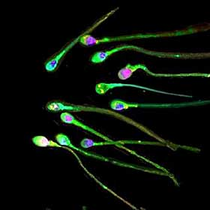
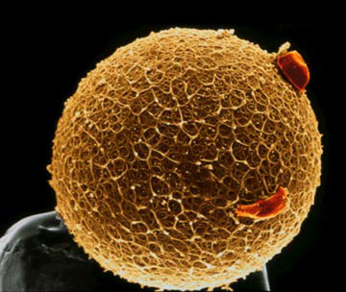
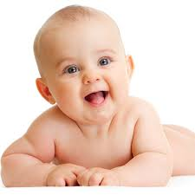
Potentiality to Actuality
The sperm and the egg have the potential to become … a baby
But something needs to cause the sperm and the egg to change from potentiality to actuality.
Some type of ‘regulated’ (ordered, precise, methodical) process has to happen.
It cannot happen on its own.

Slide 5
Aristotle was interested in this movement from potentiality to actuality… the ‘cause’ of something's existence
He thought that every single thing that is actualised- that reaches its actuality has four causes:
(four things that caused its existence)
Material cause
Formal cause
Efficient cause
Final cause

Slide 6
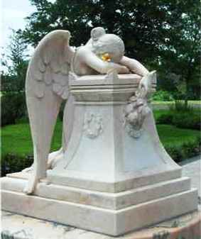
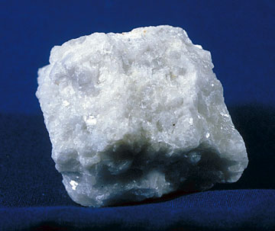
Material Cause
The things out of which an object is created.

Slide 7
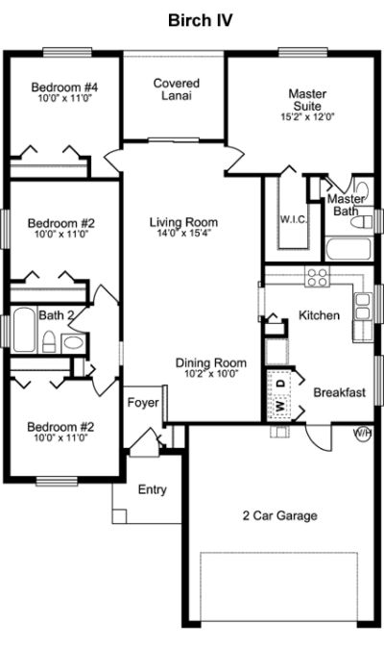
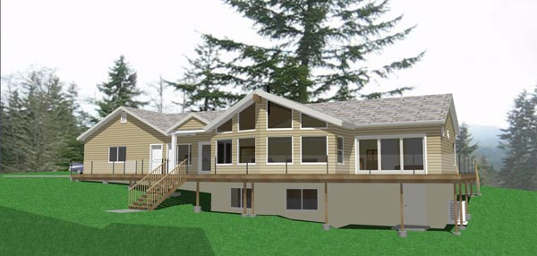
The Formal Cause
The expression, idea or plan that led to the creation of an object. Its characteristics.

Slide 8
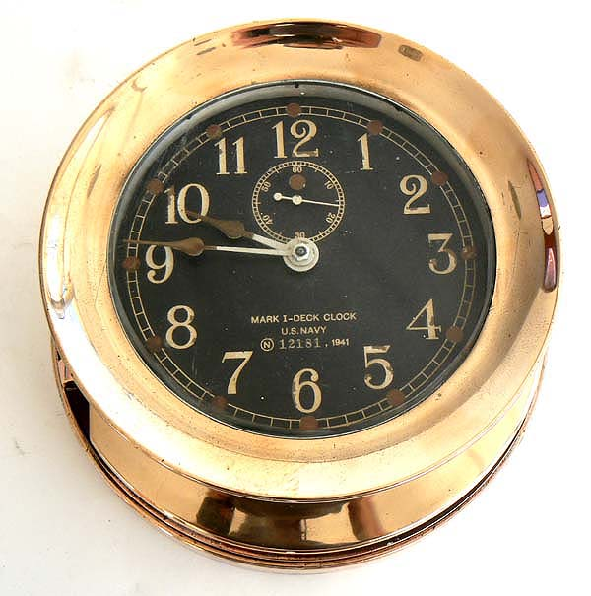
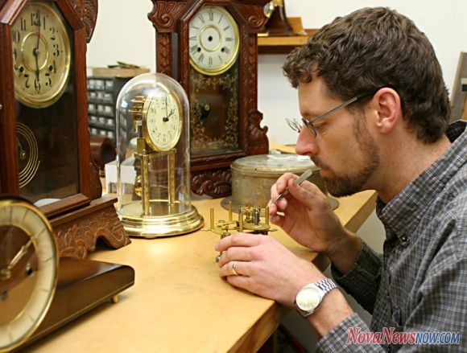
Efficient Cause
The way in which an object is created.

Slide 9
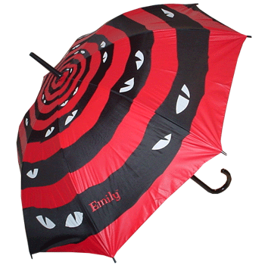
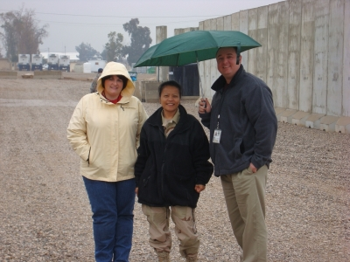
The Final Cause
The aim for which an object is created.

Slide 10
‘why and how does it exist?’
Each cause is a different kind of answer to the question "why and how does it exist?"
There are four kinds of answers to this question – answers which identify the:
matter its made out of
form it takes
source it came from
end purpose.

Slide 11
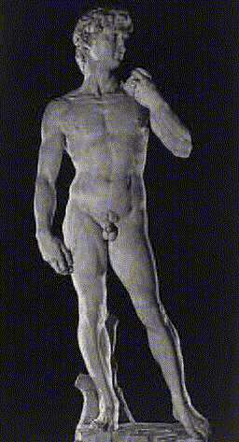
So, why and how is this a statue?
This is a statue because it is made of marble; because it is in the shape of David; because Michelangelo sculpted it; because Michelangelo wanted to depict the figure of David in marble (because he needed the money, perhaps).

Slide 12
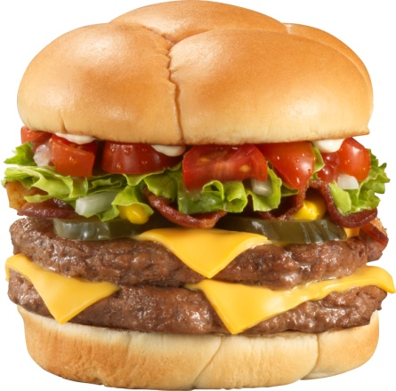
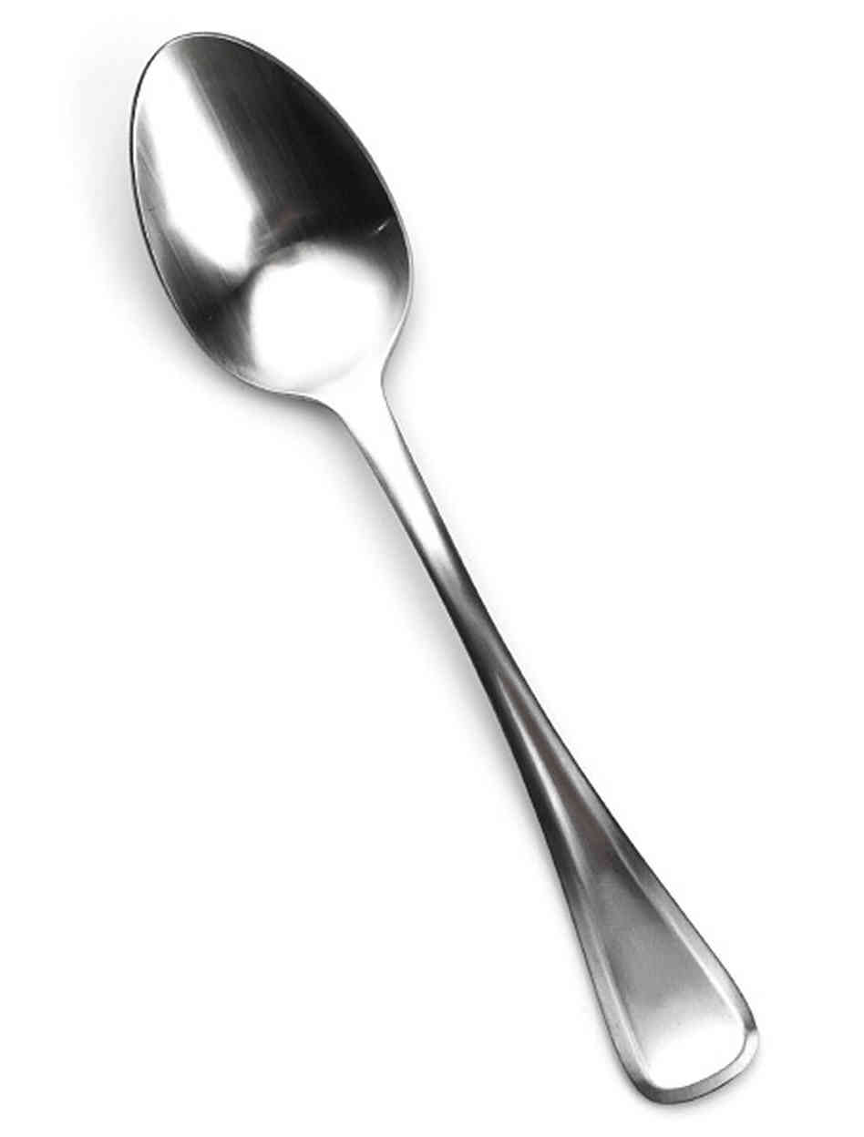
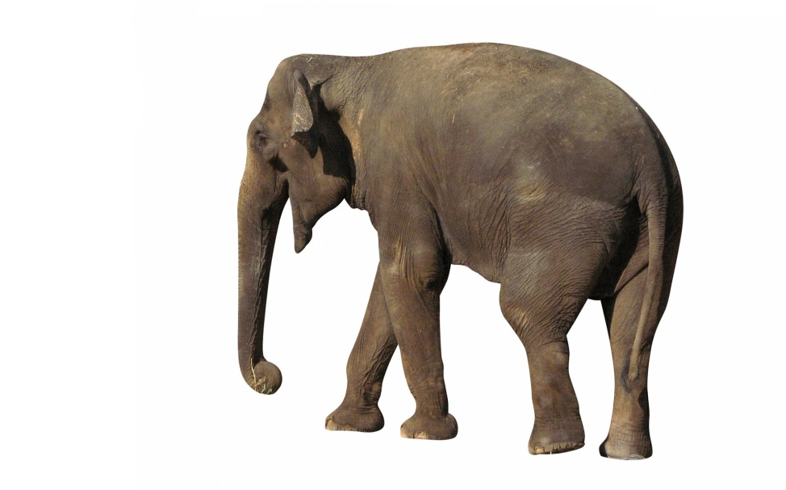
Try identifying the Four causes of some of the following..

Slide 13
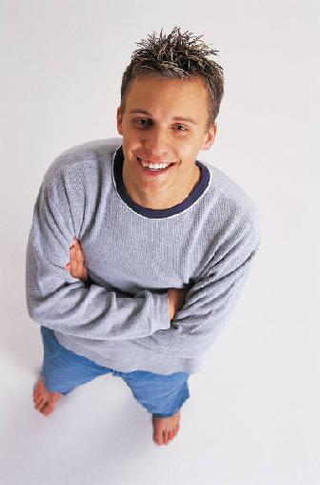
What about a human being?
What are our
Material
Formal
Efficient
Final
causes?

Slide 14
Watch the clip and make notes on how Aristotle’s ideas influenced Aquinas
http://www.youtube.com/watch?v=v0iq5kR81MM
Things to get your head around:
Only things with an end goal (aim or purpose) have a final cause- as ‘final cause’ means aim/ purpose
Things with a final cause are directed by something towards their end goal (aim or purpose)- “directed towards a specific effect beyond itself”
3. In order to reach their final goal things display regularities (a precise, ordered process)
This ties directly into Aquinas’s argument

Slide 15
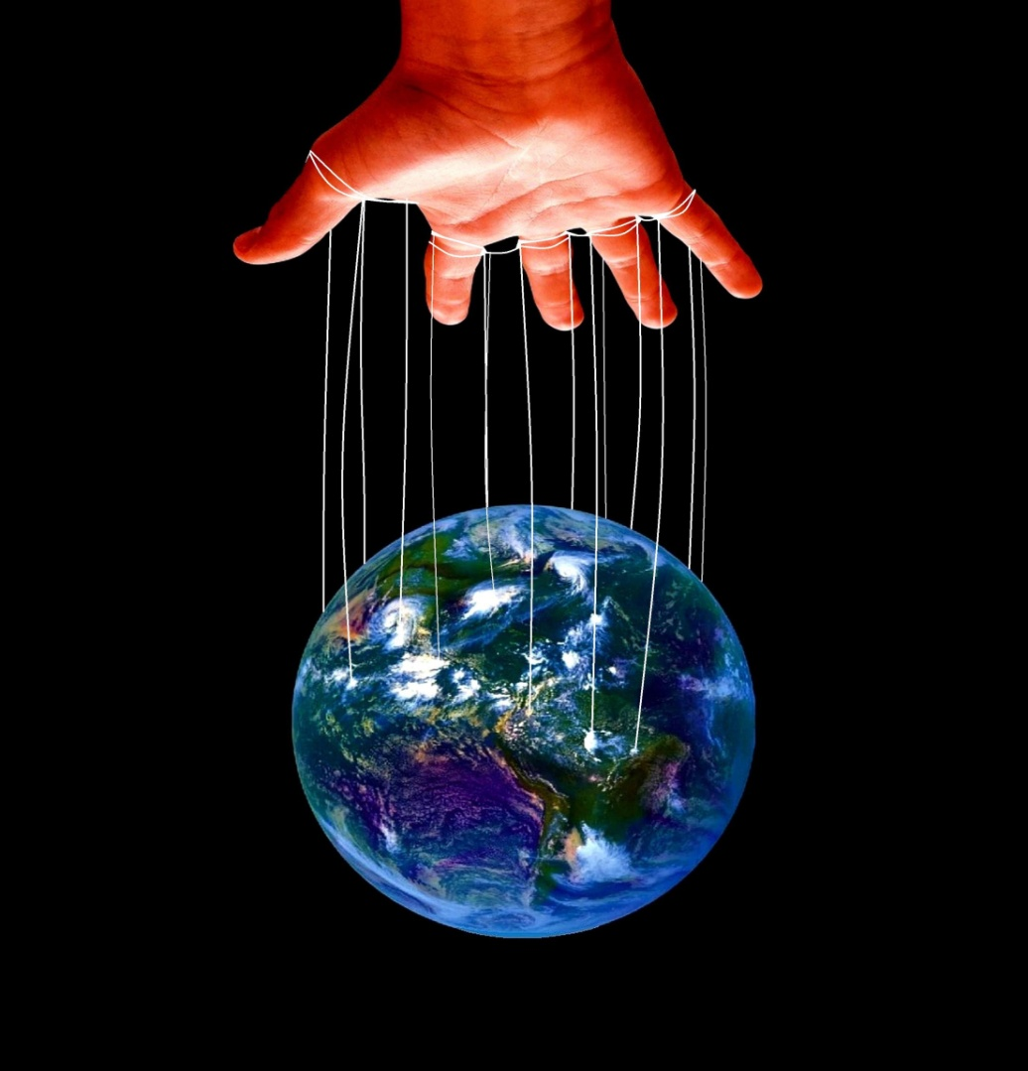
Who is regulating things to their final cause? They must be directed by something?
Aristotle (384-322 BCE)
Ancient Greek Philosopher
Not a Christian (obviously)
But did conclude an intelligent being created the world
And Aquinas built on this idea- and concluded God regulates the world and everything in it

Slide 16
Homework
Aristotle
Explain in a paragraph how Aristotle’s ideas influenced Aquinas’s teleological argument
Plato

