Slide 1
Recap
Hedonism
Key players and ideas?
B’s Theory of Motivation
What is it?
Moral Fact
What is it?

Slide 2
Initial Ideas
What were your initial thoughts?
Questions asked of any moral theory
Derivation: How is the value or norm (idea of goodness which will come from it) derived?
Application: How easy is the theory to apply to real world situations?
Realism: How realistic is the theory in its view of human nature?
Motivation: How does this theory answer the question: why should I be moral?
Acronym D.A.R.M learn and apply to any theory

Slide 3
B’s Principle of Utility
One Plus point of Utilitarianism worth remembering is that it is EGALITARIAN and DEMOCRATIC. Everyone’s happiness is taken into account on an equal measure.
Go back to your ‘Bentham’ Articles-
What does Bentham mean by Utility?
Usefulness to Society

Slide 4
How can someone measure happiness?
In pairs discuss and try to come up with 3 different ways?

Slide 5
Bentham’s technique for measuring happiness:
The Hedonic Calculus

Slide 6
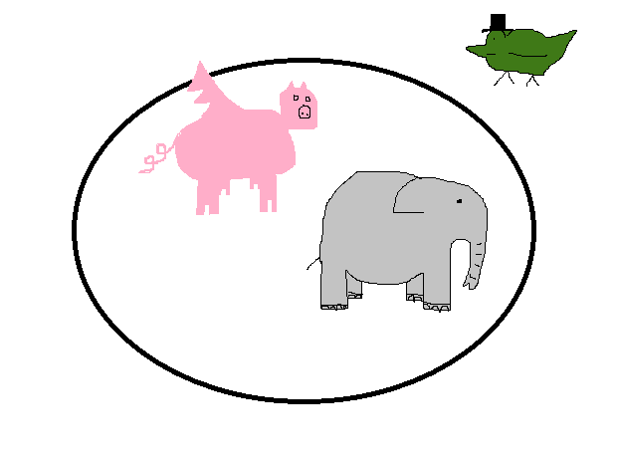
You have a choice!
Memory Method 1
Intensity -How intense is the pleasure or pain?
Duration -How long does the pleasure or pain last?
Certainty -What is the probability that the pleasure or pain will occur?
Propinquity (remoteness)- How far off in the future is the pleasure or pain?
Fecundity (richness) -What is the probability that the pleasure will lead to other pleasures?
Purity -What is the probability that the pain will lead to other pains?
Extent -How many persons are affected by the pleasure/pain?
In Duck’s Circus Pigs Fly Past Elephants

Slide 7
Memory Method 2
Purity-What is the probability that the pain will lead to other pains?
Richness (fecundity)-What is the probability that the pleasure will lead to other pleasures?
Remoteness (propinquity)-How far off in the future is the pleasure or pain?
Intensity-How intense is the pleasure or pain?
Certainty -What is the probability that the pleasure or pain will occur?
Extent -How many persons are affected by the pleasure/pain?
Duration -How long does the pleasure or pain last?
Bentham
P.R.R.I.C.E.D
Choose your memory technique, learn it and stick to it!

Slide 8
In groups you will be given a scenario, write down how the calculus can be applied to it and what it would say…
Hedonic Calculus says……..What??

Slide 9
Lets Play Articulate
The Rules:
One student stands with back to the board
The class have to describe the word to the students (not saying it obvs…!)
Students tries to guess it asap! 3 tries only…

