Slide 1
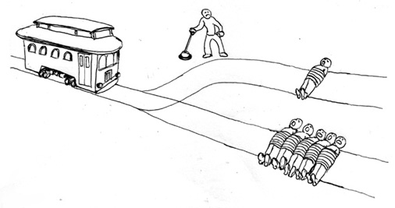
Utilitarianism
What would a Utilitarian do?
Why?

Slide 2
Where does Utilitarianism come from?
Hedonism
To think objectively and face up to an undesirable action for the sake of a better consequence
That pleasure is the highest good and only true aim of human life
To believe that good acts and sacrifices will result in higher a chance of achieving a place in heaven

Slide 3
Hedonism
Aristippus of Cyrene
Epicurus
Plato and Aristotle
Dionysus/ Bacchus
Started a cult like following based on self- interest and the pursuit of pleasure
The Portrait of Dorian Gray –Oscar Wilde
Notes:
A of C was a student of Socrates (Plato was too)

Slide 4
5 mins challenge
1st
To explain through drawing alone what Hedonism means
You will need to include lots of examples

Slide 5
10 mins challenge
2nd
What did Bentham make of Hedonism?
How did it influence his Utilitarianism?
Read his article, see if you can work out what it means and re-write it in your own modern day words

Slide 6
Bentham built on Hedonism-
Bentham’s theory of motivation:
Human beings are motivated by pleasure and pain.
He is thus a Hedonist. He believes that pleasure is the ultimate motivation.
Nature has placed mankind under the governance of two sovereign masters -pain and pleasure
“It is for them alone to point out what we ought to do as well as to determine what we shall do”

Slide 7
Moral Fact
All humans pursue pleasure and seek to avoid pain.
This is a moral fact because pleasure and pain identify what is a good or a bad action
For humans the sole good is pleasure and the sole evil is pain.
For this reason Bentham’s Utilitarianism is called ‘Hedonic Utilitarianism’.

Slide 8
Reflection-Initial Ideas
Questions asked of any moral theory
Derivation (/ Comes from?): How is the value or norm (idea of goodness which will come from it) derived?
Application: How easy is the theory to apply to real world situations?
Realism: How realistic is the theory in its view of human nature?
Motivation: How does this theory answer the question: why should I be moral?
Acronym D(/C).A.R.M learn and apply to any theory

Slide 9
Finally-
Is there anything wrong with putting pleasure at the centre of your ethical philosophy?

