Slide 1
Exercise: You have 30 happiness points to distribute across nine things.
10 mins challenge
Draw four columns marked
Put these nine in the first column: clothes, family, sport, religion, romance, study, money, freedom. Allocate your points under ‘my score’ in col 2
Work out class average for col. 3.
If that average is imposed on you, will you be happy or sad (compare col 2 and 3)? ie, does the class reflect your view?
Activity | My score | Average score | Happy/ sad?
Notes:
For criticisms

Slide 2
Problem with utilitarianism?
What does this exercise suggest might be a problem with utilitarianism?
(Think of Government policy on health, education)

Slide 3
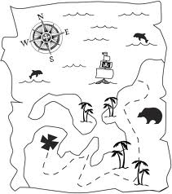
Team Treasure Hunt
The race is on-
Collect all the strengths and weaknesses of Bentham’s Act Utilitarianism onto your sheet and explain them in your own words
First team to finish get some sweets!

Slide 4
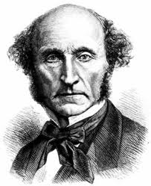
So what next:
Brought in Rules for Utilitarianism so Mill’s version became known as ‘Rule Utilitarianism’
John Stuart Mill
1806-1873
Bentham’s Godson
Mill believed that quality was more important than quantity when it came to pleasure.
For example, the pleasures of the mind are far superior to the gratification of the body’s desires.
This deals with the problem of pleasure that is of a significantly lower kind being prioritised (sex, drink, food)

Slide 5
Act Vs Rule Utilitarianism
Act utilitarianism
Looks at the consequences
of each individual act and calculates utility each time the act is performed
Rule utilitarianism
Looks at the consequences of having everyone follow a particular rule and calculates
the overall utility of accepting or rejecting the rule

Slide 6
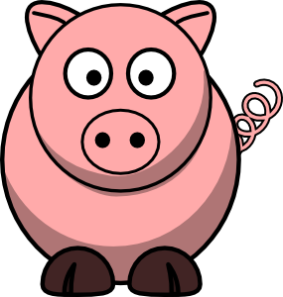
Mill Quote
“Better to be a human being dissatisfied than a pig satisfied… better to be Socrates dissatisfied than a fool satisfied”

Slide 7
Rule Utilitarians critique Act Utilitarianism by claiming:
In particular cases, act utilitarianism can justify disobeying important moral rules and violating individual rights.
Act utilitarianism also takes too much time to calculate in each and every case.

