Slide 1
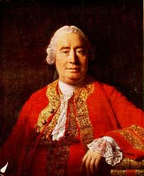
David Hume 1711-1776
“A WISE MAN PROPORTIONS HIS BELIEF TO EVIDENCE”
Scottish born
Said to be the most important British Philosopher
Argued against the design argument in his book
Dialogues Concerning Natural Religion
Visit http://www.davidhume.org/ for more information

Slide 2
Hume was an Empiricist
This means he believed the only valuable type of knowledge was that which came from verifiable experience
Therefore you cannot assume to be true anything you have not directly experienced
Thus Hume challenged and criticised the claim that God designed and created the world

Slide 3
It was illegal to be an atheist- punishable by death!
Therefore Hume had to hide his opinions. The only way he could publish his ideas was in a book with characters and a storyline whereby they discussed their different views (much like how Plato presented his ideas)
In his book Dialogues Concerning Natural Religion:
Cleanthes argues the design argument (a posteriori knowledge of God)
Philo argues Hume’s own views. The atheist critic of arguments for God’s existence
Demea argues for a faith and a priori knowledge of God, doesn’t feature in the design argument section

Slide 4
Hume puts forward his own version of a teleological argument
Despite producing major criticisms to the design argument, Hume starts by having Cleanthes put forwards a version of the teleological argument:
“Look around the world...you will find it nothing but one great machine subdivided into an infinite number of lesser machines”
Through the character of Cleanthes Hume compares the universe to a machine made up of smaller machines all working to a purpose. Since there are obvious similarities between a machine and a universe there must be similarities between the machine designer and the universe designer.

Slide 5
Hume goes on to make 5 criticisms through the character of Philo
In groups you will be given pictures that summarise Hume’s criticisms
You need to work out what your criticism is
Only then I will give you further detail about that criticism
Then present your criticism in more detail back to the class! (careful- some criticisms have a couple of points within them!)

Slide 6
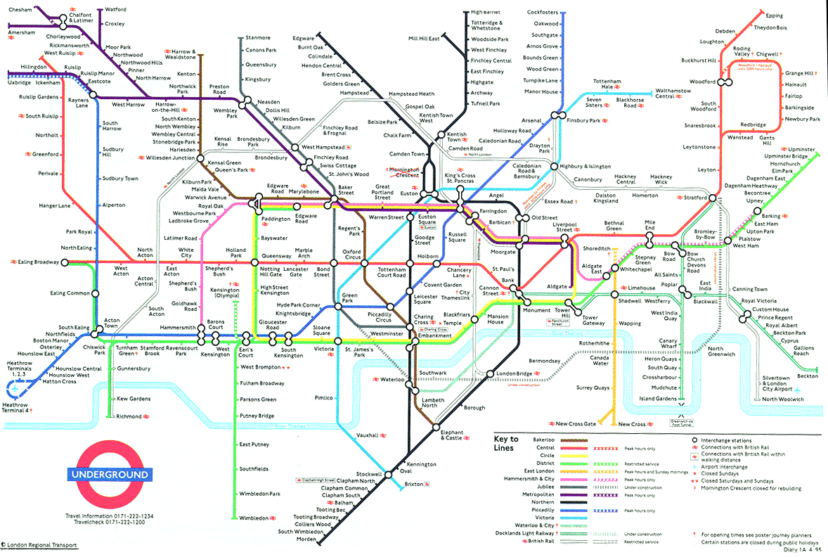

Slide 7
In an infinite amount of time a monkey would eventually write the complete works of Shakespeare

Slide 8
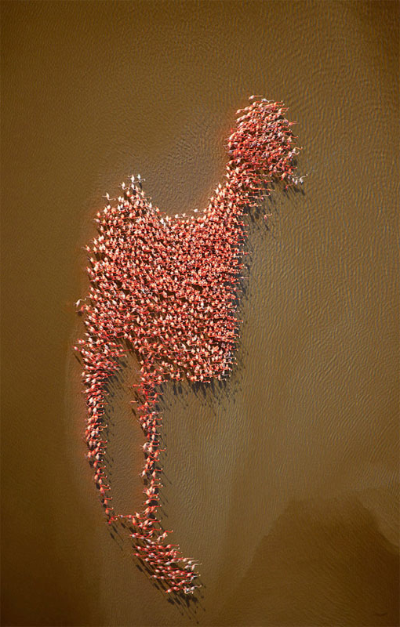
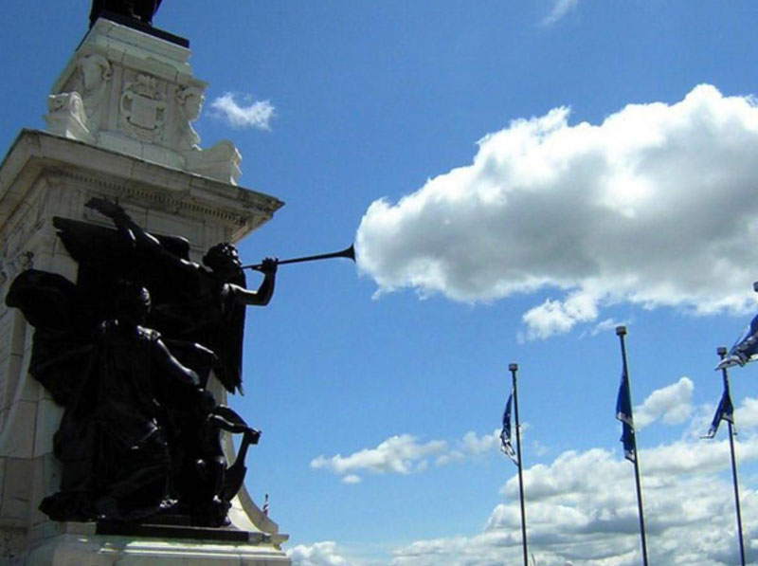

Slide 9
1. Not necessarily designed by God

Slide 10
The London Underground
Criticism 1 point 1
Who designed it?
Who maintains it?
Hume says
It is incredibly complex and has been designed
But God did not design it……
So if greatly complex things can be designed by things other than God, then a greatly complex universe could be designed by something other than God

Slide 11
Epicurean Hypothesis
Criticism 1 point 2
That the world and its apparent design could have been the result of chance.
‘It is entirely plausible that the world arose from chance’
Epicurus said: at the time of creation the universe consisted of particles in random motion. They were chaotic but gradually over a long time they evolved into an ordered system. Thus apparent design could happen at random if given long enough and does not infer a designer. Modern illustration: is that if an unlimited number of monkey’s were all randomly typewriting for an infinite amount of time they would inevitably eventually write the complete works of Shakespeare.

Slide 12
Why not?

Slide 13
2. Poor Analogy

Slide 14
Can we really compare a machine to the universe?
Criticism 2 point 1
Design arguments rely on an analogy
If the analogy is weak the argument will be too
Hume says you cannot compare a man made machine to the universe. They are too different, it would be illogical!

Slide 15
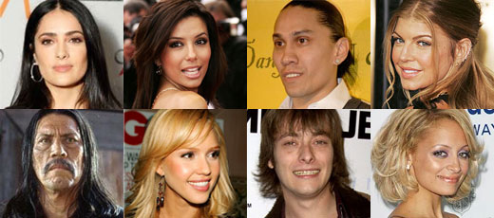

Slide 17
3. Fallacy of Composition- what’s true of the part not necessarily true of the whole

Slide 18
Fallacy of Composition
Criticism 3 point 1
It is logically incoherent to assume that because we may observe design or apparent design in parts, there must be design for the whole.
Likewise it is illogical to assume that because you have seen one Mexican with a sombrero, all Mexicans wear Sombreros.
Thus ‘what is true of the part need not be true of the whole’

Slide 20
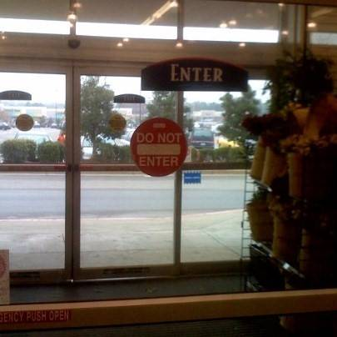
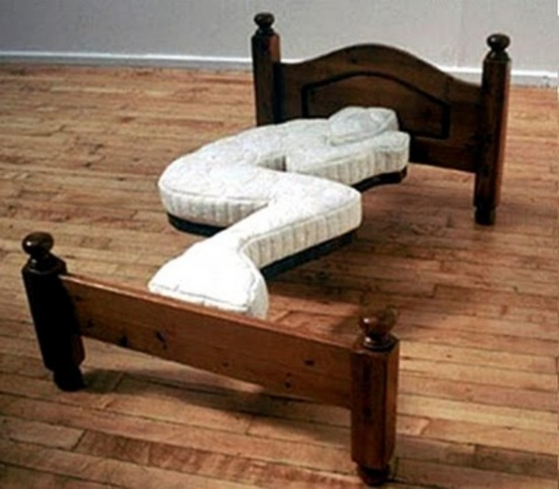

Slide 22
4. If designed- not the classical theistic deity of Judeo- Christendom

Slide 23
Natural Disasters- Evil and Suffering
Criticism 4 point 1
Were these designed? Created?
Or were they things that just ‘went wrong’?
Hume says
Things go wrong in there world. There is suffering and evil.
If there is design, it is not perfect so this contradicts the God of classical theism
Or there is no design because if God was the only possible designer, his creation would not be so imperfect as to have so many ‘wrongs’ in it
‘nature is red in tooth and claw’.
Highlights either no god or inadequacy of God

Slide 24
Team Building
Criticism 4 point 2
How many people does it take to build and create something huge and incredibly complex?
Hume says
If there is design, it doesn’t mean there is only one God
There might have been a whole team of Gods, just like a whole team of people are needed to build a house

Slide 25
Criticism 4- summary
• These points for criticism four maintain that the closer the analogy between design within the world and design of the universe as a whole, the more the picture emerges of a God who is dissimilar to the God of Classical Theism (omnipotent, omnibenevolent, omniscient etc). Rather we create an anthropomorphic God.
Anthropomorphism = limiting God to human qualities and attributes

Slide 28
5. Universe- Making: Not our experience so cannot say

Slide 29
Knowledge comes from experience- we have no experience of ‘universe making’
Our concepts of design are so limited that we cannot apply them to the creation of the world. The fact that a machine needs a designer is part of our experience of being in the world, but we have no experience of making worlds, ‘Have worlds ever been formed under your eye?’ Hume is attacking the inductive logic once more. The leap from an observation in this world does not justify a metaphysical conclusion about the creation of the world, of this we have no experience.
How could a goldfish in a pond conclude anything about the process of pond making? It has no knowledge of pond making; whether the pond is a natural formation or the work of a clever gardener could not be known by the fish unless it had experience of pond making.
Criticism 5 point 1

Slide 30
Note-
Hume's criticisms were put forward 22 years BEFORE Paley's - they were not after Paley. It is a mistake, therefore, to say that Hume was responding to Paley - it is perhaps an indication of the gap between philosophy and theology that Paley does not seem to be aware of Hume’s earlier work.

Slide 31
Homework- for Thursday
1) What are the 5 criticisms put forwards by Hume?
2) Which of these criticisms do you think are successful, why?
3) Which do you think are unsuccessful, why?

