Slide 1
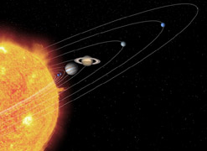
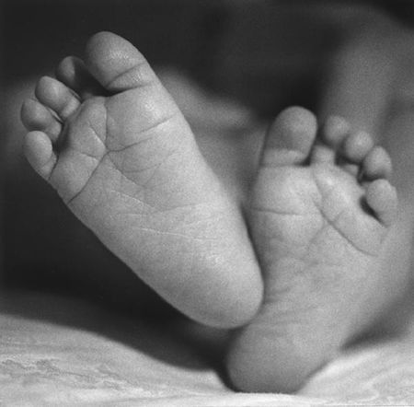
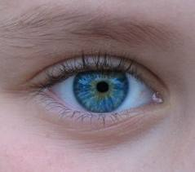
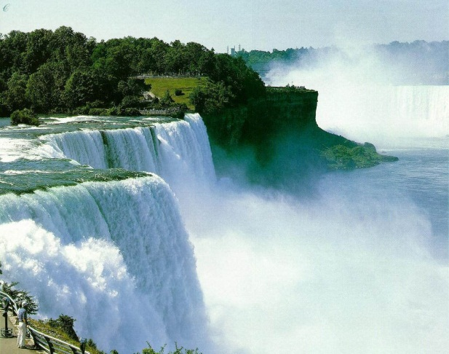
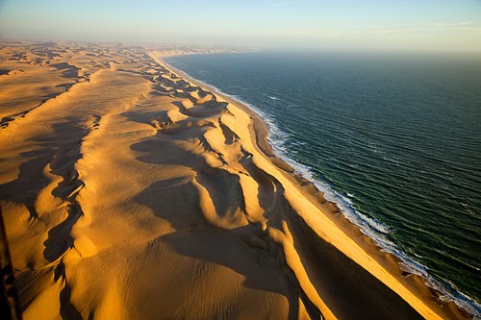
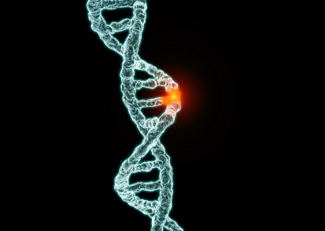
Evidence that supports/does not support the Teleological Argument...
Suitability
Disease
Order
Malfunctioning
Purpose
Benefit
Awe inspiring nature
Natural disasters
Regularity
Beauty
Destructive

Slide 2
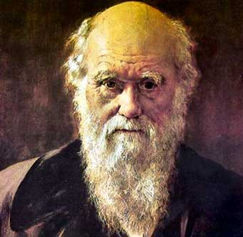
Charles Darwin
http://www.youtube.com/watch?v=vmphlbRhLu8
http://www.youtube.com/watch?v=PKtamnmrNqs
Charles Darwin was a naturalist who formulated the theory of natural selection in his work “On The Origins of Species” published in 1859.
His work developed from studying species on the various Galapagos Islands on the HMS Beagle voyage, and expanding work written by Thomas Mathus.

Slide 3
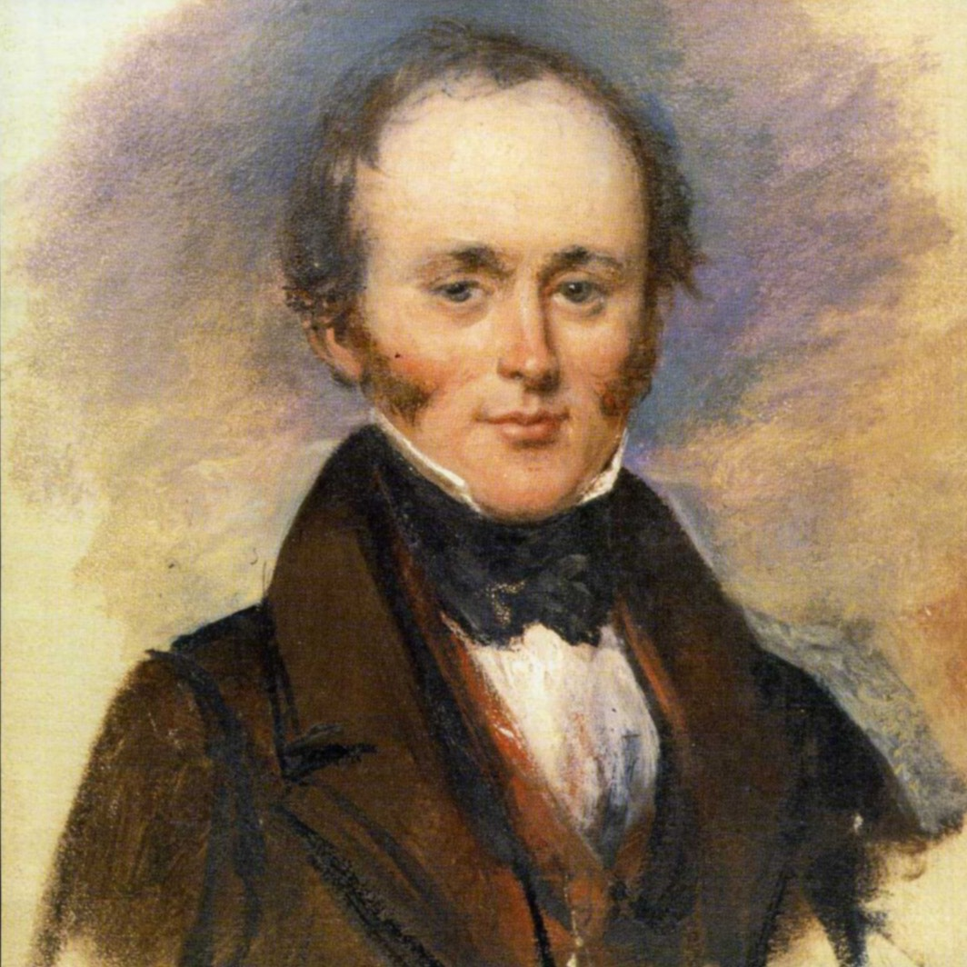
Charles Lyell
Presented one of the first major challenges to the literal view of the Bible.
UNIFORMITARIANISM
Earth formed gradually
VS
CATASTROPHISM
Earth formed all at once 4,5000 years ago
Notes:
The earth is much older than a few thousand years

Slide 4
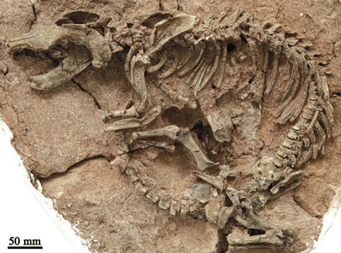
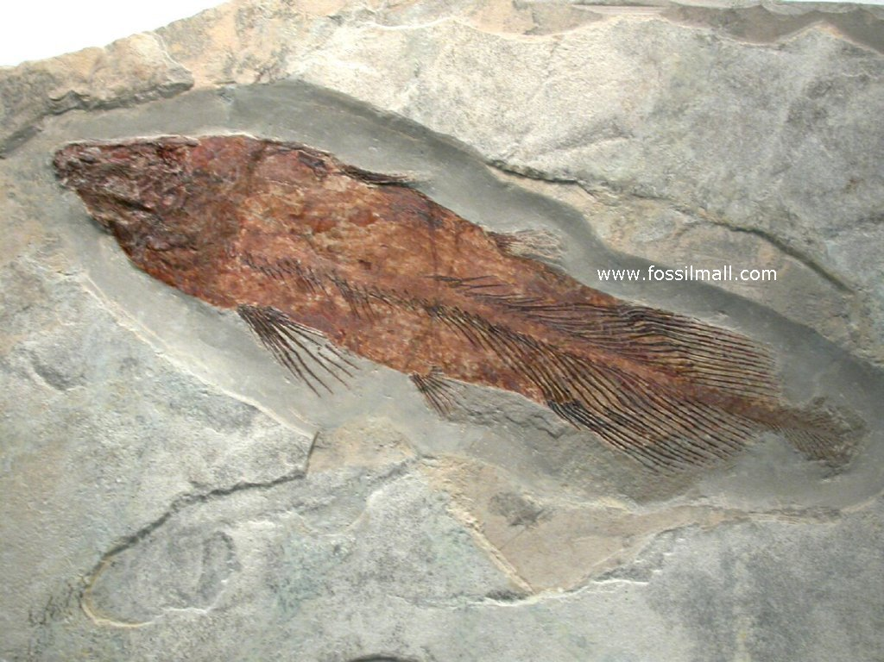
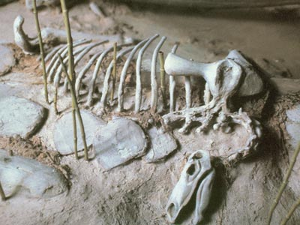
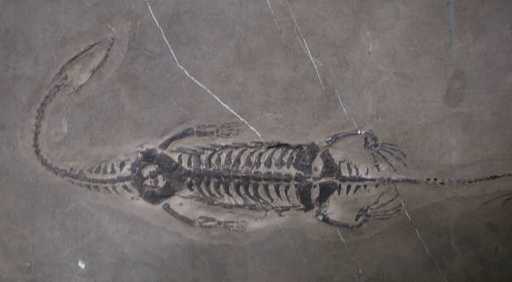
Phillip Goose

Slide 5
DARWIN’S THEORY Evolution through natural selection
When life first began, it was in a very simple molecular form. As it reproduced itself, the offspring were not identical. Those with stronger characteristics, more suitable for survival, lived longer and were able to produce more offspring to continue the strong characteristics, while the weaker traits became extinct. Over many generations, different species evolved. Complexity was one of the characteristics which led to a greater chance of survival, and so more and more complex plants and animals were formed, with different characteristics to suit different habitats.
Darwin did not attack design arguments explicitly, but his views are important because those who supported design arguments were saying that such complexity and suitability could only have come about by the agency of God. Darwin provided an alternative explanation which to many seemed a more plausible alternative that the existence of God.

Slide 6
DARWIN’S THEORY Evolution through natural selection
http://www.bbc.co.uk/learningzone/clips/evolution-of-the-eye/5522.html
http://www.bbc.co.uk/learningzone/clips/evolution-and-fossils/5523.html
http://www.youtube.com/watch?v=BgqVPFiMhA0 rabbits

Slide 7
Which is the most problematic?
Challenges to Christianity…
Humankind was not God’s supreme creation
The distinction between humankind and the rest of creation is blurred
Authority of the Bible as the revealed word of God diminished
Wonders of the natural world not attributable to God but to random chance – Designer God challenged
No unique place for humanity and no unique soul
Humankind not been deliberately created in a ready-made form

Slide 8
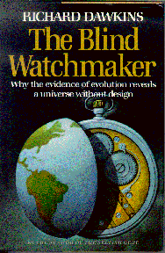
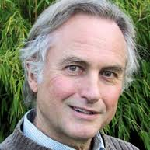
RICHARD DAWKINS
http://www.youtube.com/watch?v=VhJdai8eKic
http://www.youtube.com/watch?v=OvEl1lOc0Iw

