Slide 1
Utilitarianism and
the Application of
the Hedonic Calculus

Slide 2
Find your perfect partner
Match up the key words to their definitions

Slide 3
Applying the Hedonic Calculus- new groups new scenario
Write down what each category of the HC would say/ ask about it….
Hedonic Calculus says…….Whaaaaat???

Slide 4
Think about the A in DARM….
Is it all so easy?
Have you thought of any weaknesses or problems in the application of the Hedonic Calculus?

Slide 5
Application of Utilitarian Theory
If you can use eighty soldiers as a decoy in war, and thereby attack an enemy force and kill several hundred enemy soldiers, that is a morally good choice even though the eighty might be lost.
If lying or stealing will actually bring about more happiness and/or reduce pain, we should lie and steal in those cases.

Slide 6
Would Utilitarianism say yes or no
No, the act does not bring about more pleasure for more people
Yes, the act brings about more pleasure for more people
Choose which side of the room you think Bentham’s Utilitarianism would say

Slide 7
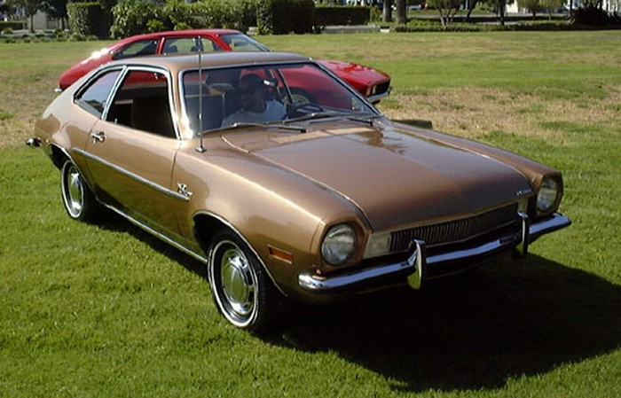
Application of Utilitarianism Actual Cases
The decision at Coventry during WWII. The decision was made not to inform the town that they would be bombed- to prevent panic etc.
The Ford Pinto case: A defective vehicle model was not recalled and repaired by Ford because they felt it was cheaper to pay the liability suits than to repairs all the defective cars.

Slide 8
HWK- ESSAY QUESTION
Explain Bentham’s Act utilitarianism. 30 marks
You should explain the development and three aspects of the theory
Motivation
Utility
Hedonic calculus
You should also apply the theory to an ethical scenario explain it further.
Remember to use the PEE system.

Slide 9
Lets Play Articulate
The Rules:
One student stands with back to the board
The class have to describe the word to the student using definitions or examples (not saying it obvs…!)
Students tries to guess it asap! 1 try only…

