Slide 1
And what do these phrases from Aquinas’ argument mean?
The governance of things
The way things are controlled, regulated and ordered (governed)
Things lacking cognition
Things that are innate- do not have their own intelligence
Tend toward a goal
Everything has a purpose and aim

Slide 2
Aquinas’ 5th way summarised- have a go at summarising the 5 key points
Premise 1- everything in the world follows natural laws and order for a purpose (e.g human eyes/ bird’s beaks, etc)
Premise 2- even innate things lacking intelligence are governed by a natural order and regularity (e.g. trees, crops, the sea, the planets)
Premise 3- innate things lacking own intelligence cannot direct themselves, must be directed by some other intelligent thing (e.g. an arrow cannot direct itself to the target or follow laws of motion, gravity, speed etc on it’s own- it needs the archer to direct/ design it)
Premise 4- Therefore the universe, as it is governed by natural laws and order, must be directed and regulated by something intelligent
Conclusion- the only thing capable of directing and regulating the universe must be God. Therefore God exists

Slide 3
This tree knows when to shed its leaves, yet it doesn’t have intelligence like human beings
According to Aquinas, God regulates the tree to make it do this

Slide 4
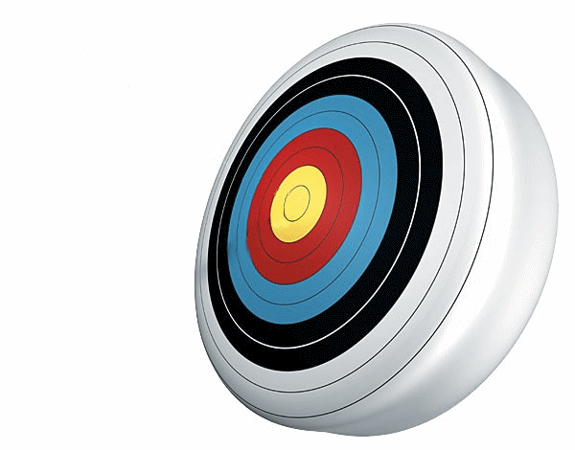
Thomas Aquinas
Analogy of the arrow and the archer
Have a go at explaining the analogy yourself
as the arrow is shot to its mark by the archer. Therefore some intelligent being exists by whom all natural things are directed to their end; and this being we call God.

Slide 5
Unintelligent objects can only reach their goal with the help of a guiding intelligence

Slide 6
Aquinas Paley

Slide 7
Aquinas Paley
13th century
18th century
Both use an analogy in their argument
Started arguing from regularity and order
Started arguing from purpose
Compares innate things under human control to innate things not under human control
Both use examples from the world e.g. Four seasons
Compares a complex machine to the complex universe
Both have same conclusion- an intelligent being in exists
Uses the complexity of biological organisms to
Support his argument
- e.g. Human eye
Influenced by Aristotle’s
four causes

